Slide 1












Protracted Displacement Economies
Mike Collyer (University of Sussex) & Becky Mitchell (IDS)

Slide 2


Policy context
79.5 million Forcibly Displaced – 26m refugees
77% (15.7m refugees) in ‘protracted’ situation
85% hosted in ODA recipient countries, 27% in ‘Least Developed’
Global Refugee Compact signed December 2018.
Focus on increase in sustainability and ‘self reliance’

Slide 3

Primary Research Questions
How do protracted displacement economies operate and how can this be made more sustainable?
How does the market function in protracted displacement economies?
What is the significance of non-market activities and how are they valued?
How can protracted displacement economies become more sustainable?

Slide 4


Theoretical Focus
A whole-of-society approach
‘The displacement affected community’
An inclusive approach to economies
Including non-financial transactions

Slide 5
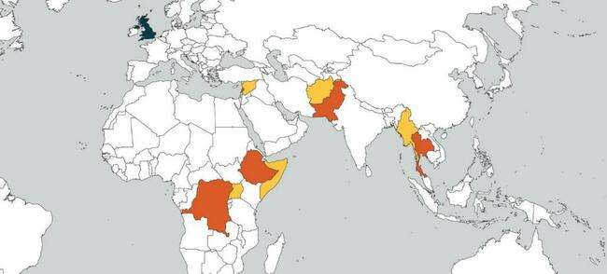





Geographical Scope
Democratic Republic of Congo / Uganda
Ethiopia / Somalia
Lebanon / Syria
Pakistan / Afghanistan
Thailand / Myanmar

Slide 6











Project Partners
Ethiopia / Somalia
Pakistan / Afghanistan
Myanmar
The Funders
Democratic Republic of Congo / Uganda
United Kingdom
Lebanon / Syria

Slide 7
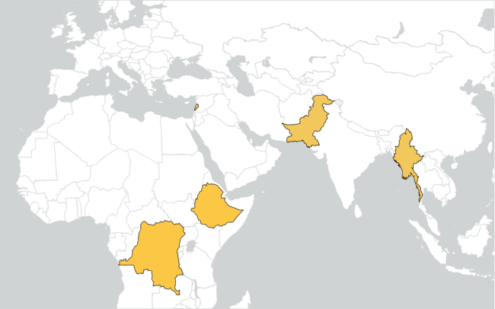
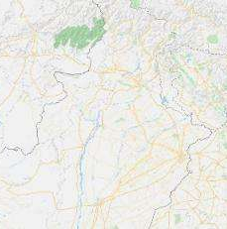
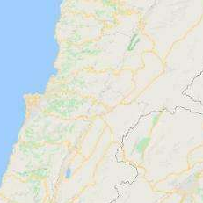
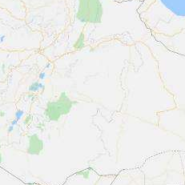
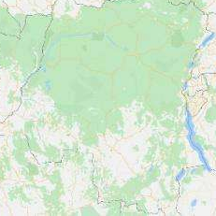
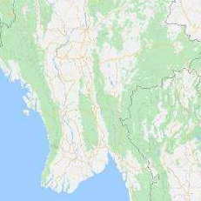
Chitral
Afghanistan
Haripur
Peshawar
Islamabad
Beqaa Valley
Beirut
Lebanon
Syria
India
Pakistan
Myanmar
Somalia
Ethiopia
Addis Ababa
Jigjiga
Massisi
Locations in Karen State
?
Kalehe
Rwa
Bur.
Kinshasa
Dolo Odo
Thailand
Somalia
Yangon?
Angola
Dem. Rep. of Congo

Slide 8
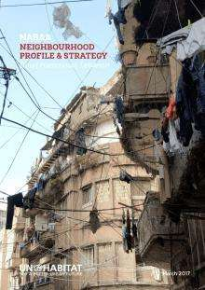
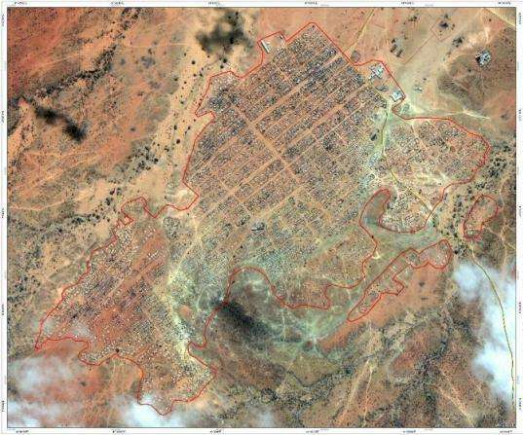
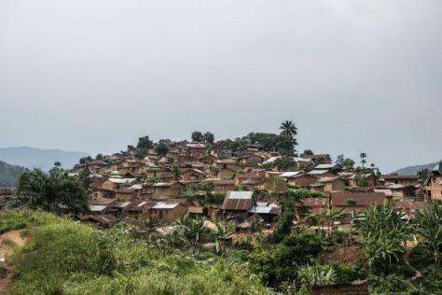
2. Refugee camp
(Melkadida, Dolo
Ado)
1. Urban neighbourhood (Beirut)
3. Other area
(South Kivu)

Slide 9






Research Methods
 | 12 | 3,000-4,000 | 350 | 150 | 30-40 | 10-12
 | 12 | 3,000-4,000 | 350 | 150 | 30-40 | 10-12
 | 12 | 3,000-4,000 | 350 | 150 | 30-40 | 10-12
 | 12 | 3,000-4,000 | 350 | 150 | 30-40 | 10-12
 | 12 | 3,000-4,000 | 350 | 150 | 30-40 | 10-12
 | 60 focus groups | 15-20,000 households | 1,750 households | 750 interviewees | 150-200 stakeholders | 50-60 filmakers

Slide 10
The challenges of research during COVID-19
Minimizing exclusion of groups most likely to be left out of research as a result of COVID19 - those who…
  Lack access to technology or digital literacy
  Are socio-economically deprived
  Have lost childcare/support
  Have new or exacerbated mental health problems
  Are unwell
Notes:
In addition to this, unintentional exclusion from research can happen when:
research tools require a level of access to technology, excluding those without access, in particular women and low-income families
reaching and choosing participants requires a level of access to technology
participatory methods were planned, to include marginalised groups, which will be problematic to use remotely, potentially removing this vital element from collaborative research (and mitigating this with technology risks the exclusion outlined above).
So, an important question for researchers is how to ensure that they are reaching the most marginalised and invisible populations if they are not physically there? Is this even possible, and safe? And if not, should the research be changed, or wait for face-to-face participation to resume?

Slide 11
The challenges of research during COVID-19
Maximising ethics
  Consent
  Settings
  Risk
Notes:
Lockdowns and restrictions resulting from the Covid19 pandemic have produced a number of ethical challenges for research, that should be considered carefully. Briefly these issues can be grouped into consent, the interview/focus group setting, and risk management.
Consent - Obtaining informed written consent using remote technologies can be problematic when you are not able to obtain a physical signature or discuss the process face to face. To overcome this, consent forms could be sent, discussed and returned via email. Oral consent could be considered, particularly if it’s possible to record it. This would need to be outlined during the ethical clearance process.
Setting – participating in online research, remotely, has been found to blur the participants understanding of the setting, in some circumstances making them ‘forget’ the research context within which the conversation is taking place, particularly when people are inside their own homes. While this offers rich data gathering opportunities, it also makes it more important to remind them that they are being interviewed and/or recorded. Some research participants have admitted surprise about how open they were during online interviews rather than in a more formal face to face setting. Remembering also that there may also be privacy issues related to participants and facilitators carrying out research from within their own homes, or potentially public spaces.
Risk - Ensuring that all researchers keep themselves and their participants safe, do not take unnecessary risks or feel in any way obligated to do so is vital to all research, but most especially in current circumstances. A robust participatory risk management process is essential including the perspectives of everyone involved, not just that of the researchers based in the country that is leading the research. Finding ways to ensure open communication about risk management between local researchers on the ground and the rest of the team is crucial.

Slide 12
The challenges of research during COVID-19
Overcoming practical issues
  Contact
  Connectivity
  Communication
  Workload
  Funds for technology and training
  Secondary data
  Sampling strategies
Notes:
Researchers identified the following practical issues and solutions relating to carrying out research during Covid19:
Contact. Levels of contact with participants will vary. If research is continuing in an area where research has previously been carried out, remote contacts should already be in place. Alternatively, it may be possible to work through community mobilisers, including some capacity building. If research in an area is completely new, identifying and working with new community mobilisers may require some initial face to face contact but this would at least minimise contacts.
Connectivity. Getting access to a strong enough internet connection to carry out voice or video calls is difficult. Research projects could divert travel funds to invest in improved internet connections for local researchers, research organisations and participants.
Communication issues. Communicating through voice calls and video calls makes research really difficult, compared to face-to-face contact. Using voice-notes to follow-up and continue communication with participants after an interview or focus group discussion has been a useful way to continue research and build relationships and trust.
Additional workload. All the potential changes to research discussed here involve additional workload. This extra work may fall to country-based teams. We need to make sure that all team members are supported and compensated appropriately and that nobody is placed under even more stress because of the research.
Assigning research funds to enhance access to technology, such as better internet coverage.
Considering the use of secondary data instead of data collection; investigating more thoroughly what already exists and if it can be used to complement or replace the planned primary research.
Designing sampling strategies to deliberately include ‘hard to reach’ groups.

Slide 13
The challenges of research during COVID-19
New opportunities
  Capacity building
  Technological
  Environmental
Notes:
Despite the myriad issues associated with carrying out primary research during Covid19, there may also be new opportunities to work differently, and perhaps even improve practice. Examples of these opportunities include:
Capacity building
Capacity building within local partners, so that they can take on more responsibility, and lead research not just during Covid19 but also in the future.
Capacity building within UK-based partners – in creating effective remote support packages for in-country operatives.
Using the opportunity of online activities to create cross-programmatic learning and knowledge exchange that may not have been considered in ‘normal’ times; bringing research teams together from around the world to talk through issues, such as ethics, risks, research practices and sampling strategies.
Technological
Using online methods to help break down the barriers for potential participants to take part in research. For example, when dealing with sensitive issues, people can feel more comfortable doing this through a screen, sitting in their own homes. And there is no need for participants to find time to travel to focus group or interview locations. If participants and ethics allow, recording sessions can provide a rich data source that may have been missed during face-to-face activities.
Experimenting with different digital research methods (if you follow this link – digital methods kick in at minute 9). For example, using photo scavenger hunts with smart phones to glean rich information about participants’ settings and the kind of problems they face. Other platforms such as itracks, 20/20 Research, Civicom, and Discuss.io have advanced features that enable researchers to delve more into the arts-based side of qualitative methods.
Environmental
Acknowledging the positive global environmental impact of reducing and stopping travel and flights for all researchers.
Considering and acknowledging the issues that research during Covid19 can raise and communicating openly and clearly about this is key. Being open to different ways of working can create new, perhaps better ways of working that may endure, even when Covid19 is a distant memory. Even when face to face research is possible, it may take some time to establish confidence amongst participants.

Slide 14
What we’ve achieved so far in PDE…
What we’ve done so far…
Community profiling – in some contexts – carried out virtually and with local partners visiting communities
Increased use of local partners
Our short-term research plans
Focus groups
  Limited to smaller numbers
  Context dependent – some virtual, some face to face (with social distancing/masks/moving outside etc), some voice calls, some delayed completely
  Flexible timing - depending on context and what is possible
  Changing methods to make them COVID safe
  Change in the delivery of surveys – print them out and deliver them – and discuss over the phone
  Change in some of the participatory methods – using the technology people do have access to
Notes:
What we’ve done so far..
Community profiling – in some contexts has been possible – it has been carried out both virtually and with local partners visiting communities, or with local partners who have existing knowledge of communities
We have relied much more heavily on local partners to carry out parts of the project that we had anticipated doing ourselves – or at least being present for and helping with. This has been successful, and definitely gives us something to think about with future work and travel, and whether we are needed in these settings.
Our short-term research plans
We do plan to carry out some focus groups but these will be limited to smaller numbers of participants in all settings, and they will be different to what was originally planned. The changes will be context dependent – some virtual, some face to face (with social distancing/masks/moving outside etc), some voice calls, some delayed completely and we have had to shift to be much more flexible on timings, again depending on the context and what is possible.
We have also started to plan changes to our research methods going forward, thinking about how we can change them to make them COVID safe, without compromising the quality of the research in the process. Some ideas around that include -
Change in the delivery of surveys – print them out and deliver them – and discuss over the phone
Change in some of the participatory methods – using the technology people do have access to

